Slide 1
Human Computer Interaction (HCI) Lecture 2

Slide 2
User-Centered Design (UCD)
User-centered design (UCD) is an approach to user interface design and development that involves users throughout the design and development process.
User-centered design not only focuses on understanding the users of a computer system under development but also requires an understanding of the tasks that users will perform with the system.

Slide 3
User-Centered Design (UCD)
The four main principles of human-centered design are:
The active involvement of users
2. An appropriate allocation of function between user and system
3. The iteration of design solutions
4. Multidisciplinary design teams

Slide 4
User-Centered Design (UCD)
The four essential human-centered design activities are:
Understand and specify the context of use
2. Specify the user and organizational requirements
3. Produce design solutions (prototypes)
4. Evaluate designs with users against requirements

Slide 5
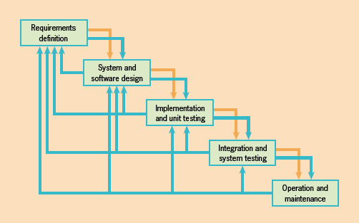
Classic Life Cycle (CLC)
Also known as the waterfall model, so named because of the cascade from one phase to another

Slide 6
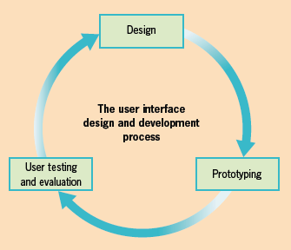
Difference bet. UCD and CLC
User interface design and development is based on the premise that users should be involved throughout the design life cycle.
Additionally, the process should be highly iterative, so that the design can be tested with users to make sure it meets the users’ requirements

Slide 7
Involving Users
Who Are the Users?
In a user interface design project, developers generally refer to several types of people as users:
• Customers, who pay for and perhaps specify the computer system under development
• Other people within the users’ organizations who have an interest in the development of the system
• Users or end users —the people who actually use the system directly to undertake tasks and achieve goals
Hint: to avoid confusion, from this point on we will reserve the term “users” for the end users of a computer system.

Slide 8
Needed for UI Design
The Two Types of Knowledge Needed for UI Design
• Information-gathering activities and analyses that form part of the user
interface design and development process
• User interface design knowledge—for example, design principles and design rules.

Slide 9
Interviewing Your Users
Interviewing involves talking to or questioning users. It enables the gathering of information in a fast and friendly way.
You will need to plan interviews carefully, deciding in advance who to interview, what questions to ask to gather the relevant information, and how long the interviews should be.
There are two main kinds of interview: structured and unstructured (flexible).

Slide 10
Structured & flexible interview
A structured interview has predetermined
questions that are asked in a set way; there is little, if any, scope for exploring additional topics that might arise during the interview.
A flexible interview generally has some set topics for discussion and exploration, but no set sequence: the interviewer is free to follow up the interviewees’ replies, and to find out more about anything that is said.
A flexible interview is less formal than a structured interview and is very useful early in the design process for gathering requirements and gauging users’ opinions about a particular idea.

Slide 11
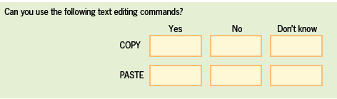
Questionnaires
Types of Question Structure
A closed question asks the respondent to select an answer from a choice of alternative replies. Closed questions may require just “yes” or “no” responses

Slide 12
Questionnaires
Types of Question Structure
An open question allows respondents to say whatever they like in response, and they are used where there are no predetermined answers. Open questions typically start with phrases such as “What do you . . . ,” “How do you . . . ,” or “What ways . . . .”
Open questions provide richer data than do closed questions

Slide 13
Questionnaires
There are several points to keep in mind when designing a questionnaire:
• Make the process easy for the person who is answering by keeping the
questions simple, and ask as few questions as possible;
• Make sure the questions are clear and unambiguous
• Make sure the questions will gather the information you need.
• Provide opportunities for your respondents to offer information that you may
not have thought about; for example, you might include some open questions
or an “any other comments” box.

Slide 14
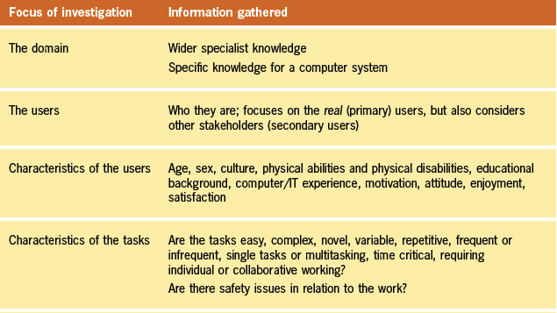
Areas and Information Gathered

Slide 15
Goals, Tasks, and Actions
A goal is an end result to be achieved.
A goal must be described at a high level of abstraction, indicating what is to be achieved.
A task is a structured set of related activities that are undertaken in some sequence. Tasks are what a person has to do (or thinks she or he has to do) in order to accomplish a goal
An action is defined as an individual operation or step that needs to be undertaken as part of the task.

Slide 16
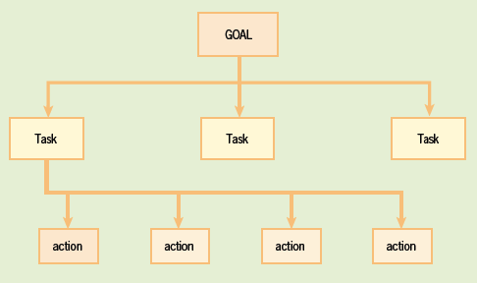
Goals, Tasks, and Actions
Goals, tasks, and actions will be different for different people, depending on their previous experience and knowledge

Slide 17
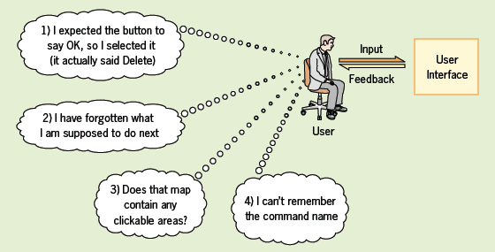
Design Principles & Design Rules
Four psychological principles:
• Users see what they expect to see.
• Users have difficulty focusing on more than one activity at a time.
• It is easier to perceive a structured layout.
• It is easier to recognize something than to recall it.

Slide 18
Design Principles & Design Rules
Three principles from experience:
• The principle of visibility: It should be obvious what a control is used for.
• The principle of affordance: It should be obvious how a control is used.
• The principle of feedback: It should be obvious when a control has been used.

Slide 19
The Next Lectures
Lecture 3: Interaction design
Lecture 4: Interaction Styles
Lecture 5: Choosing Interaction Devices: Hardware Components
Lecture 6: Choosing Interaction Elements: Software Components
Lecture 7: Moving from Choosing Components into Design Areas
Lecture 8: Designing a Graphical User Interface (GUI)
Lecture 9: Designing for the Web
Lecture 10: The Design of Embedded Computer Systems and Small Devices

Slide 20
THANKS

